Slide 1

Nestlé Customer Experience Analysis in 2020
Created by CR

Slide 2
Agenda

Slide 3
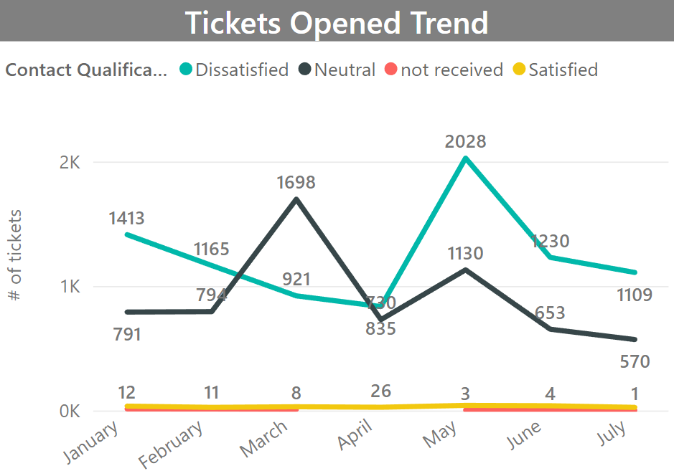
Tickets Opened in Engage System
Customers are dissatisfied with their contact experience in six out of seven months between January and July 2020.
Among all tickets, what’s the main contact reason?

Slide 4
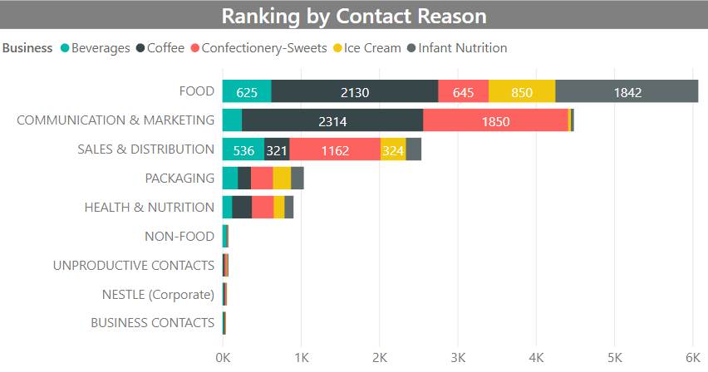
What is the main contact reason?
The main contact reason is Food related.
35% of food tickets mentioned Coffee and almost 30 % of tickets mentioned Infant Nutrition.
Following food tickets, customers also contacted us for Coffee’s Communication and Confectionery’s Sales & Distribution.
Next we deep dive into Food tickets for details.

Slide 5
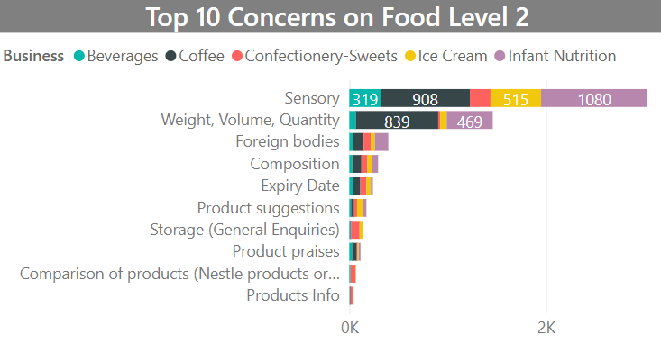
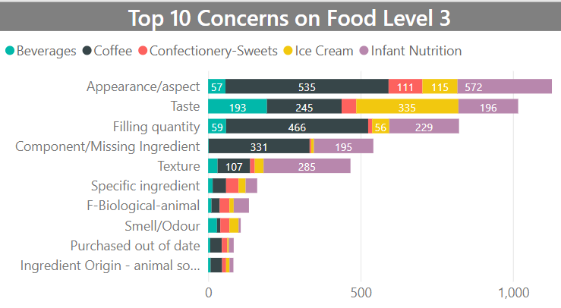
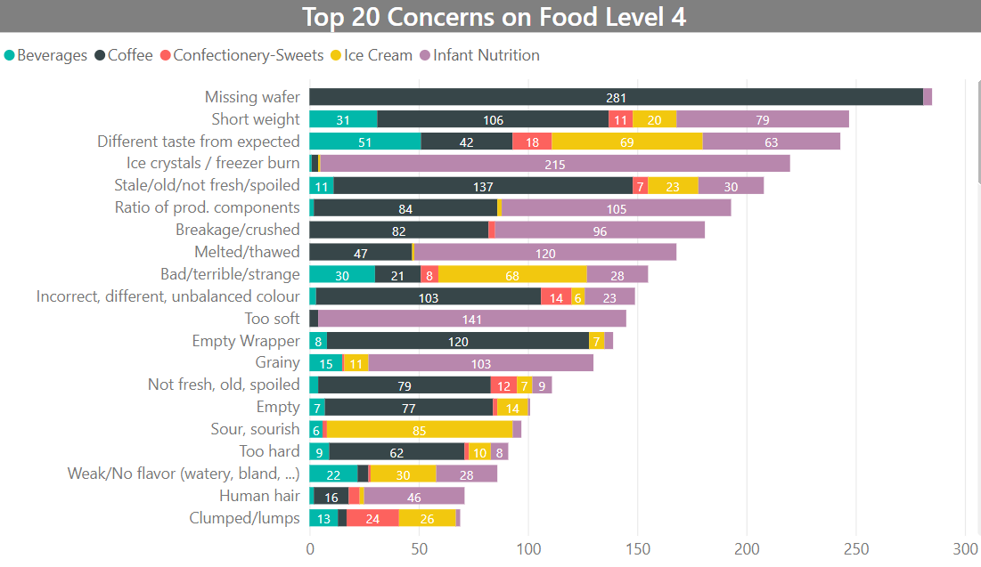
Deep Dive into Food Tickets
Customers are not satisfied with product appearance for Coffee (3.5%) , Infant Nutrition (3.7%).
1.4% of Customers notice there are ice crystals inside of Infant Nutrition products. This might cause potential health hazard for infants. It needs immediate attention from management.
There are many Coffee products missing wafer, 1.8% of customers mentioned that.
And the filling quantity and weight for coffee and infant nutrition are questioned by 5% of customers.
Moreover, 2.2% of customers complain Ice Cream and Beverage tasting different from expected.
If time allows, will deep dive into Communication and Sales.
Next we want to know which business has the most number of tickets
Notes:
Coffee: appearance and filling quantity, missing wafer and no fresh
Confectionery: appearance, find lumps.
Infant nu: appearance, texture, filling quantity, ice crystals, melted
Ice cream: taste different
Beverage: taste different

Slide 6
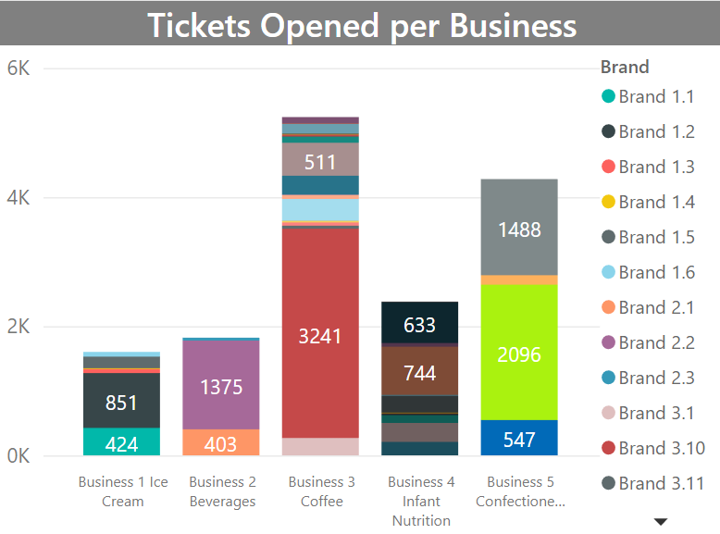
Which business was mostly mentioned in Engage System?
Most tickets were on Business 3 Coffee, especially Brand 3.10.
Considered last slide on food tickets, customers complain Coffee’s appearance the most, following is filling quantity, missing wafer and no fresh.
Still need to consider communication and sales if time allows.
Following that is Business 5 Confectionery-sweets with Brand 5.2.
Deep dive in Coffee and Confectionery. What’s the main contact reason for this 2 businesses?
Brand 5.2
Brand 3.10

Slide 7
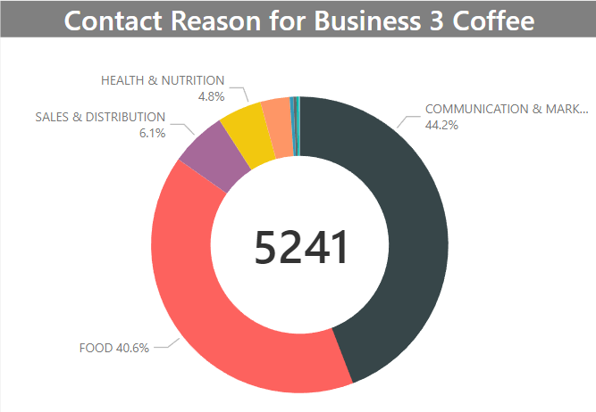
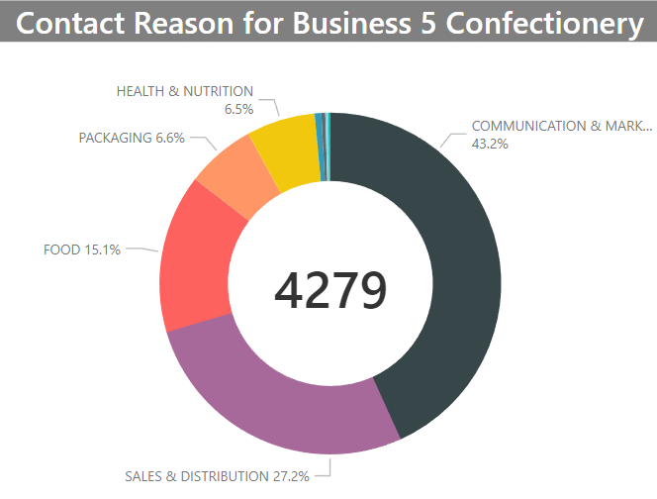
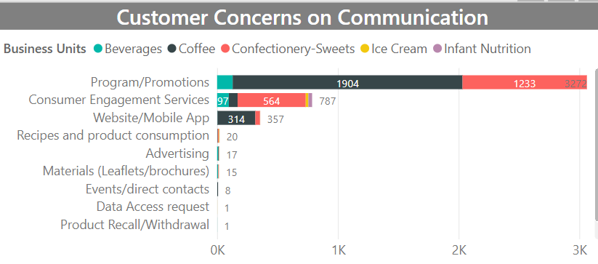
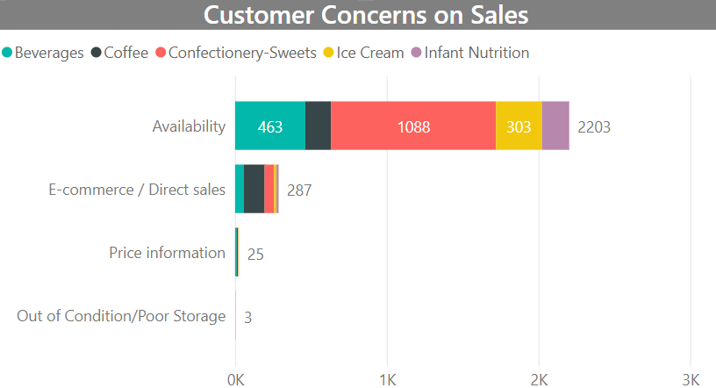
Deep Dive in Coffee and Confectionery for Contact Reason
There are 5241 tickets on Coffee, mainly relating to Food and Communication&Marketing.
4279 tickets on Confectionery, mostly relating to Communication& marketing and Sales&Distribution
Need more time analyze communication and sales.

Slide 8
NLP (natural language Processing)→automated language solution
NLP Techniques:
Segmentation: break article into sentences
Tokenizing: break sentence into words
Stop words
Are, and, the
Stemming
Doing, does, did mean the same
Lemmatization
Am/are/is→Be
Speech Tagging
Noun/verb/preposition
Name Entity Tagging
Let machine to learn from movie, conversation, map, newspaper
Statistical method: Machine apply Naïve Bayes
Use case of NLP:
grammar checking techniques learned from school,
Online Tool: Grammarly
Decipher language structure (破译)

Slide 9
Any questions?

